Slide 1
Machine Learning
Jack Y Yu

Slide 2
Agenda
Machine Learning Introduction
Systemic machine learning process
Unsupervised Learning & Supervised Learning
Modeling
Evaluate

Slide 3
Machine Learning Introduction

Slide 4
A Friendly Introduction to Machine Learning
A Friendly Introduction to Machine Learning.mp4

Slide 5
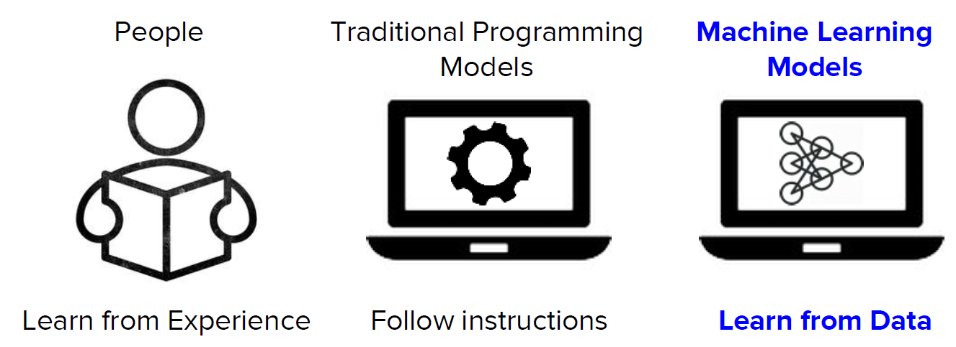
What is Machine Learning?

Slide 6
What is Machine Learning?
A computer program is said to learn from experience E with respect to some task T and some performance measure P, if its performance on T, as measured by P, improves with experience E.
- 1997, Tom Mitchell
Data
Experience E
Machine Learning System
Skills
Improvement at task T measure by P

Slide 7
What is Machine Learning?
A computer program is said to learn from experience E with respect to some task T and some performance measure P, if its performance on T, as measured by P, improves with experience E.
- 1997, Tom Mitchell
Machine Learning is the science of getting
computers to act without being
explicitly programmed.
- Andrew Ng (吴恩达)
Machine learning is a technique of data science that helps computers learn from existing data in order to forecast future behaviors, outcomes, and trends.
- Microsoft

Slide 8
Systemic machine learning process

Slide 9
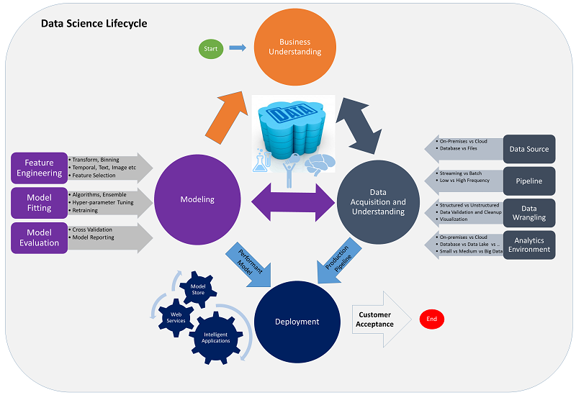
Team Data Science Process
Business Understanding
Data Understanding
Data Preparation
Modeling
Evaluation
Deployment
https://docs.microsoft.com/en-us/azure/machine-learning/team-data-science-process/

Slide 10
Business Understanding
Goals
Specify the key variables that are to serve as the model targets and whose related metrics are used determine the success of the project.
Identify the relevant data sources that the business has access to or needs to obtain.
How to do it
Define objectives: Work with your customer and other stakeholders to understand and identify the business problems. Formulate questions that define the business goals that the data science techniques can target.
Identify data sources: Find the relevant data that helps you answer the questions that define the objectives of the project.

Slide 11
Business Understanding
Do you need machine learning?
Can you formulate your problem clearly?
Do you have sufficient examples?
Does your problem have a regular pattern?
Can you find meaningful representations of your data?
How do you define success?
Frame the Machine Learning Problem

Slide 12
Business Understanding - Example
Do you need machine learning?
High manual effort to monitor store shelves every day
Detecting products in images not possible with simple rules
Can you formulate your problem clearly?
Given a shelf image, first detect products and then compare their positions with the planned shelf
layout
Input: photo; output: bounding boxes of products
Do you have sufficient examples?
Large volume of collected retail shelf pictures, manually labelled bounding boxes of products
Does your problem have a regular pattern?
Product packaging has regular shape, colors, and logos
Can you find meaningful representations of your data?
Represent photos as array of pixel values
Image patches with products are positive examples; random patches are negative examples
How do you define success?
Measure precision and recall of predicted bounding boxes and similarity of the detected layout to the true layout

Slide 13
When should you use machine learning ?

Slide 14
Data Understanding
Goals
Produce a clean, high-quality data set whose relationship to the target variables is understood. Locate the data set in the appropriate analytics environment so you are ready to model.
Develop a solution architecture of the data pipeline that refreshes and scores the data regularly.
How to do it
Ingest the data into the target analytic environment.
Explore the data to determine if the data quality is adequate to answer the question.
Set up a data pipeline to score new or regularly refreshed data.

Slide 15
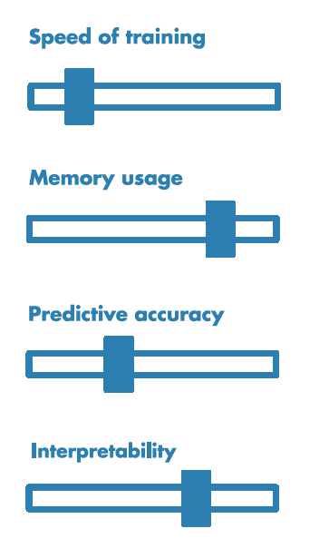
Modeling
Goals
Determine the optimal data features for the machine-learning model.
Create an informative machine-learning model that predicts the target most accurately.
Create a machine-learning model that's suitable for production.
How to do it
There are three main tasks addressed in this stage:
Feature engineering: Create data features from the raw data to facilitate model training.
Model training: Find the model that answers the question most accurately by comparing their success metrics.
Determine if your model is suitable for production.

Slide 16
Deployment
Goal
Deploy models with a data pipeline to a production or production-like environment for final user acceptance.
How to do it
The main task addressed in this stage:
Operationalize the model: Deploy the model and pipeline to a production or production-like environment for application consumption.
Operationalize the model:
Online websites
Spreadsheets
Dashboards
Line-of-business applications
Back-end applications
Notes:
After you have a set of models that perform well, you can operationalize them for other applications to consume. Depending on the business requirements, predictions are made either in real time or on a batch basis. To deploy models, you expose them with an open API interface. The interface enables the model to be easily consumed from various applications, such as:

Slide 17
“Machine Learning” Process
Business KPI
1 Refine Target/Metric
2 Extract Derived Features
5 Evaluate Model
3 Select Features
4 Fit Model

Slide 18
Supervised & Unsupervised

Slide 19
Unsupervised Learning
Clustering
Dimension reduction
Reinforcement Learning
Learn from simulated data generated by agent-environment interaction
Learn by trial-and-error through reward and punishment
Email intent recognition
Word2Vec
Learn from labeled data
Learn from unlabeled data
Classification
Email intent classification
Booking cancellation prediction
Regression
MT release/return forecast
Vessel utilization forecast
Dynamic ETA
Sequential decision
Commodity
Supervised Learning

Slide 20
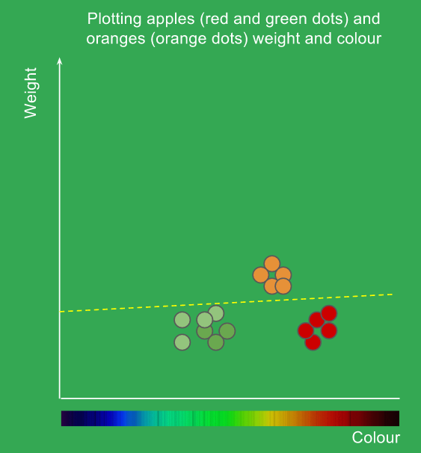
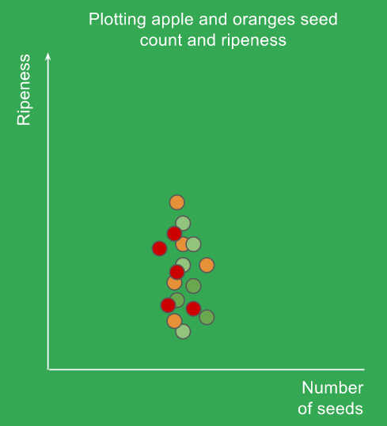
Supervised learning system
Task: to classify orange and apple
Watermelon
Feature
Label
ID | Color | Weight | Label
1 | Red | 260 | Apple
2 | Red | 240 | Apple
3 | Orange | 340 | Orange
4 | Green | 220 | Apple
5 | Green | 200 | Apple
… | … | … | …
m | Orange | 380 | Orange

Slide 21
Supervised learning system
Learn from labeled data
Trained model can be used to do prediction
Cannot predict stuff that it does not know about

Slide 22
Unsupervised learning system
Feature
ID | Color | Weight
1 | Red | 260
2 | Red | 240
3 | Orange | 340
4 | Green | 220
5 | Green | 200
… | … | …
m | Orange | 380

Slide 23
Un-supervised learning system
Learn from unlabeled data
Used to find some intrinsic pattern of data but no prediction
Manual effort required to interpret meaning of the clustering result
Can be used as a feature of supervised learning system

Slide 24
Supervised: All data is labeled and the algorithms learn to predict the output from the input data.
Unsupervised: All data is unlabeled and the algorithms learn to inherent structure from the input data.
Semi-supervised: Some data is labeled but most of it is unlabeled and a mixture of supervised and unsupervised techniques can be used.

Slide 25
Supporting Tools
Python
Pandas / Numpy
Scikit-Learn
Notes:
Jupyter notebook

Slide 26
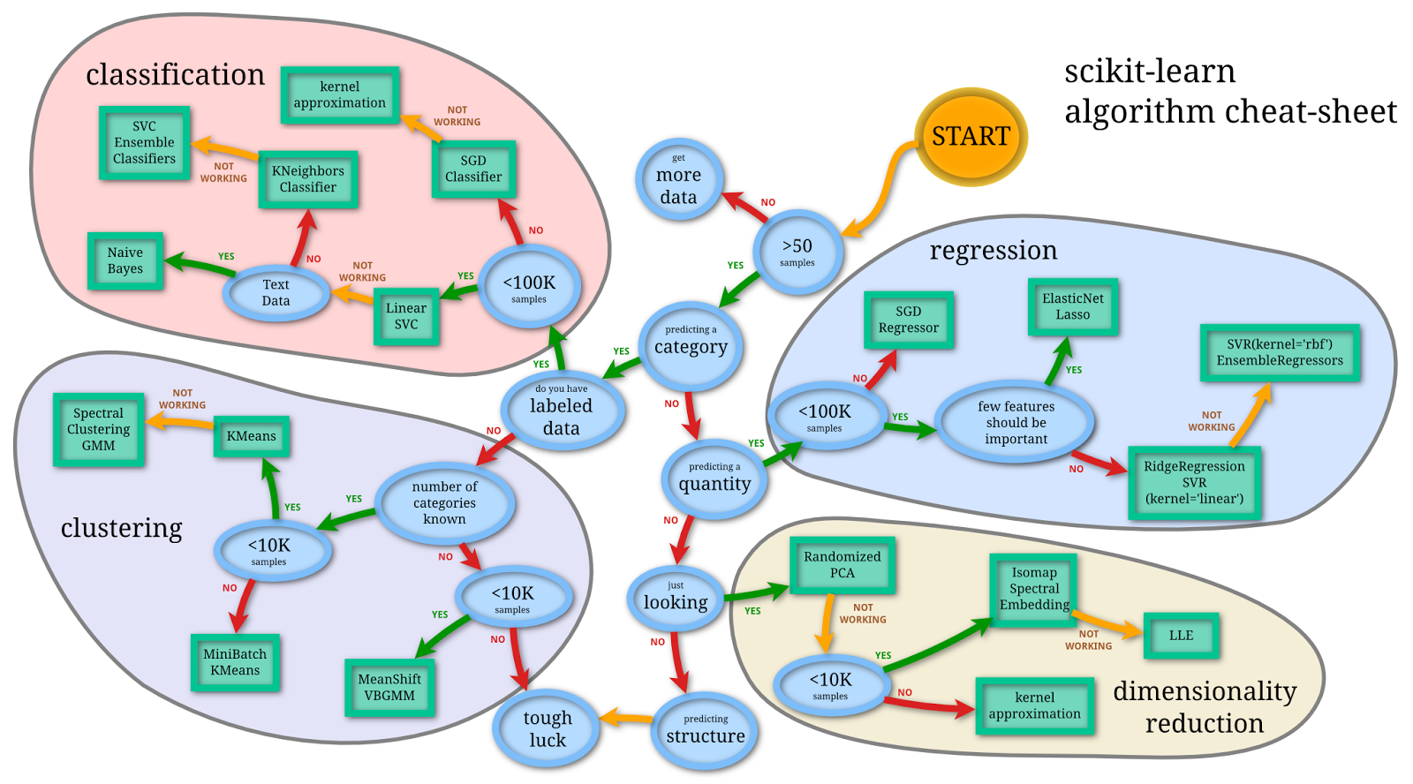
Scikit-learn
Notes:
http://scikit-learn.org/stable/index.html

Slide 27
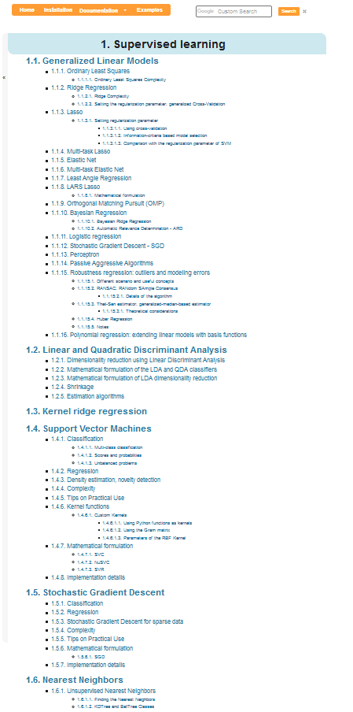
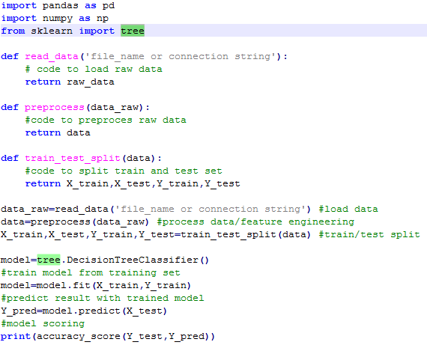
Supervised learning with python scikit-learn
1. New a model
2. Fit the model
3. Do prediction
4. Evaluate the model
That’s it!
http://scikit-learn.org/stable/supervised_learning.html

Slide 28
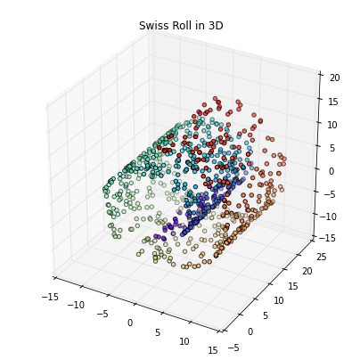
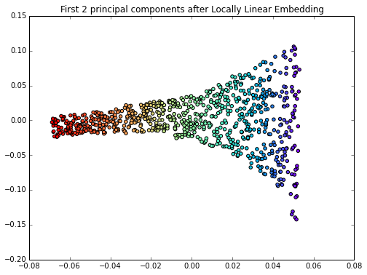
Unsupervised Learning
Unsupervised
Clustering
Compression

Slide 29
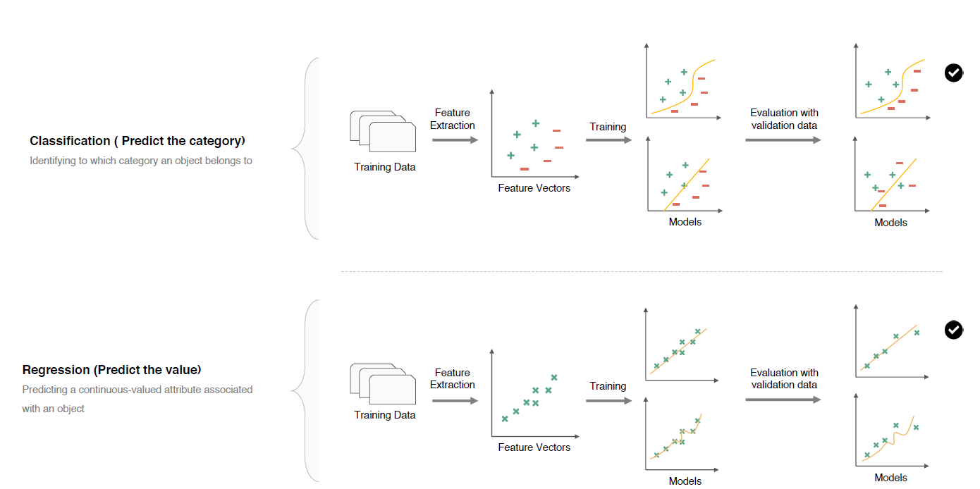
Supervised Learning

Slide 30
Modeling
Feature
Feature extraction
Feature selection
Algorithm
Liner Regression
Logistic Regression
Decision Trees
SVM
Naïve Bayesian
KNM
K-means
Random Forest
Notes:
Model training
数据集是一组描述客户订单随时间变化的关系文件集。竞争的目标是预测哪些产品将在用户的下一个订单。

Slide 31
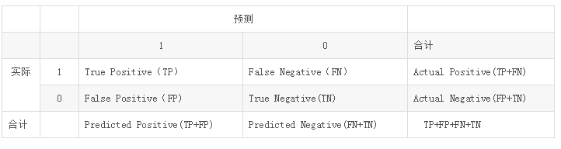
Evaluate
CM(TP,FP,FN,TN)
Notes:
Accuracy,Precision,Recall,F1,FPR,TPR
https://www.jianshu.com/p/d9990ae8172e
from sklearn.metrics import accuracy_score, f1_score, precision_score, recall_score, classification_report, confusion_matrix Accuracy_Score = accuracy_score(Test_label, predicted_label)
Precision_Score = precision_score(Test_label, predicted_label, average="macro")
Recall_Score = recall_score(Test_label, predicted_label, average="macro")
F1_Score = f1_score(Test_label, predicted_label, average="macro")
当正负类样本差数量距很大时，ROC的就不能很好的反应分类器的真实性能了，这时候PR将是更好的选择。
证明：当FP的数量有比较大的变化时，FP_rate= FP / N 因为N很大，所以FP_rate不会有很大变化。
但是PR=TP /TP +FP ,它可以捕获到这个差异，所以效果会更好。

Slide 32
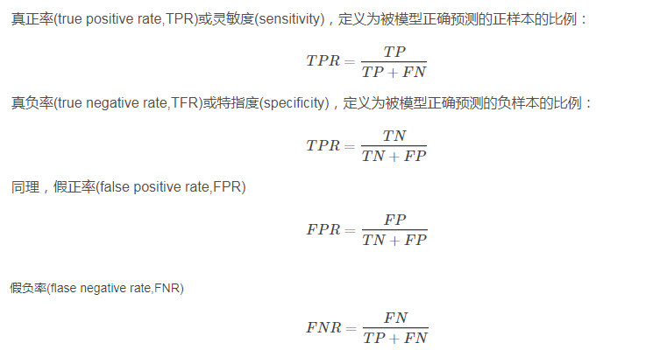

Slide 33
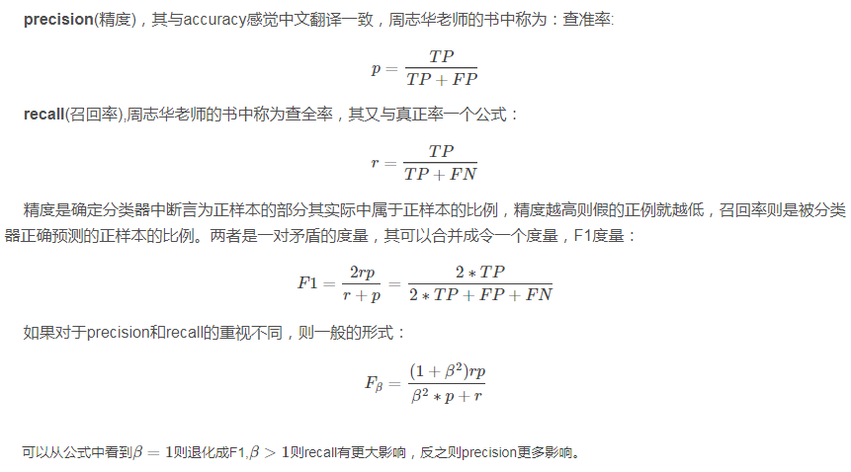

Slide 34
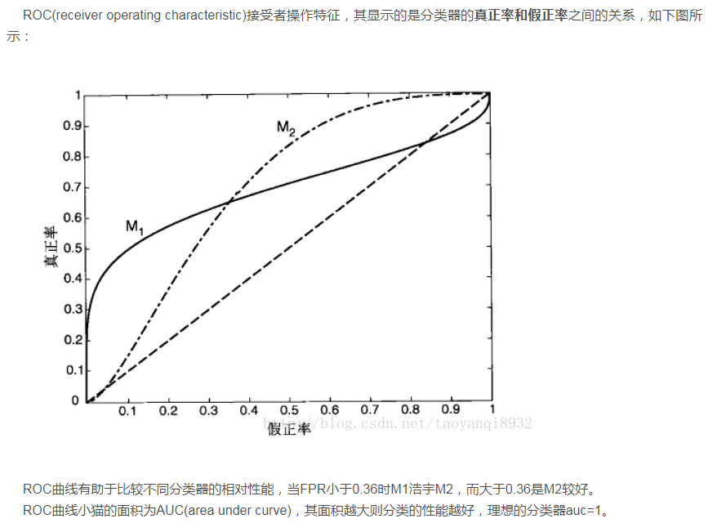

Slide 35
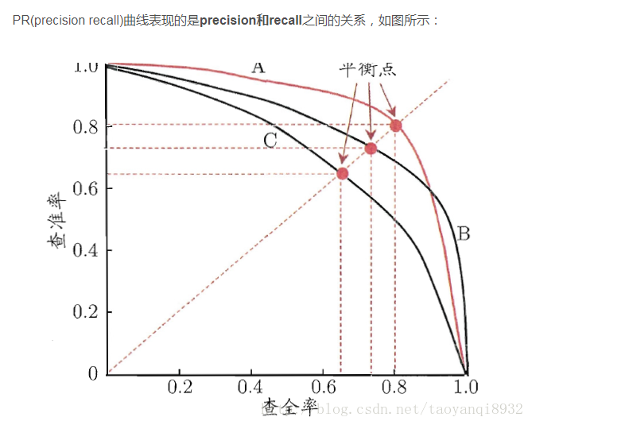
Notes:
if true negative is not much valuable to the problem, or negative examples are abundant. Then, PR-curve is typically more appropriate. For example, if the class is highly imbalanced and positive samples are very rare, then use PR-curve
如果是不平衡类，正样本的数目非常的稀有，而且很重要，比如说在诈骗交易的检测中，大部分的交易都是正常的，但是少量的非正常交易确很重要。

